Slide 1
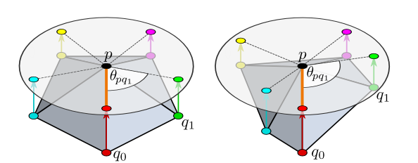
CS 7180: Geometric Deep Learning
Lecture 12:Gauge-Equivariant Networks

Slide 2
Mathematical Background
(Riemannian) Manifolds
Tangent Space and Tangent Bundle
Local Framing
Parallel Transport
Gauge Invariance

Slide 3
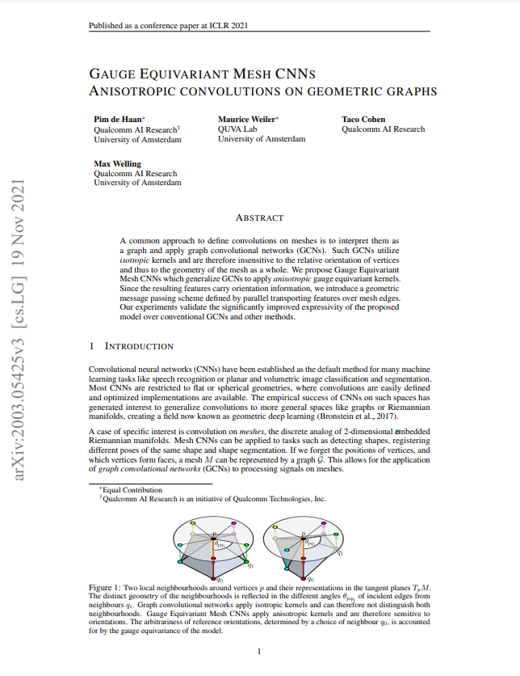
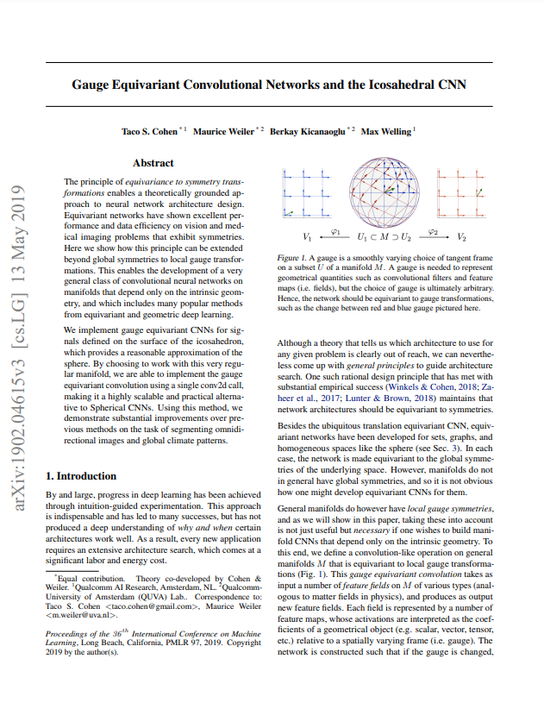
Gauge-Equivariant Neural Networks
https://arxiv.org/pdf/2003.05425.pdf https://arxiv.org/pdf/1902.04615.pdf

Slide 4
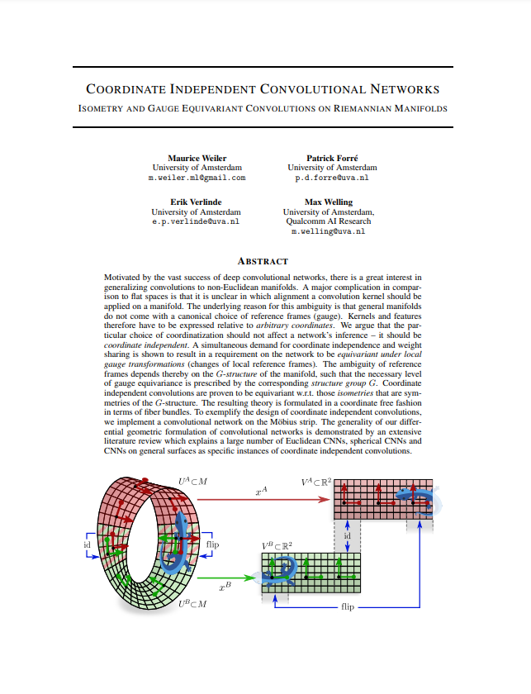
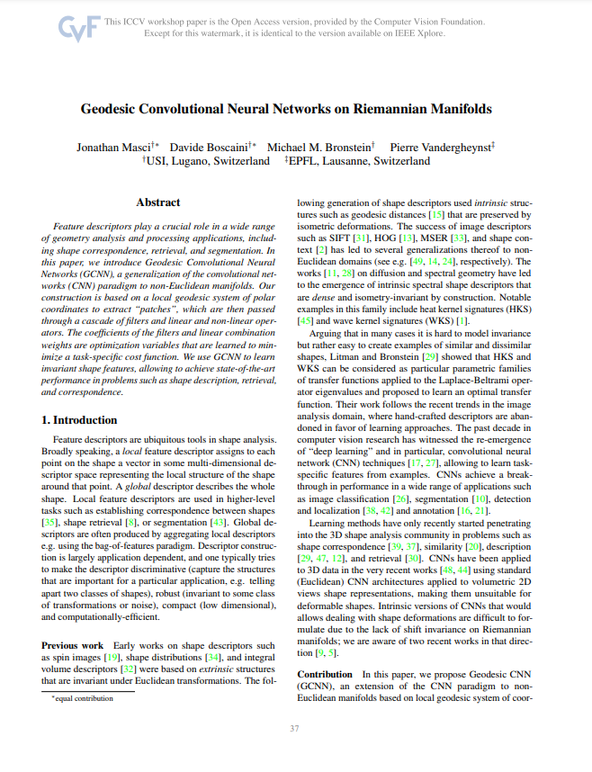
Gauge-Equivariant Neural Networks
https://www.cv-foundation.org/openaccess/content_iccv_2015_workshops/w22/papers/Masci_Geodesic_Convolutional_Neural_ICCV_2015_paper.pdf
https://arxiv.org/abs/2106.06020

Slide 5
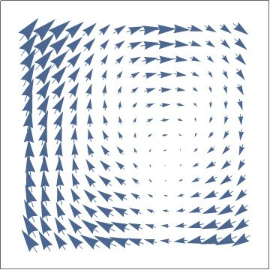
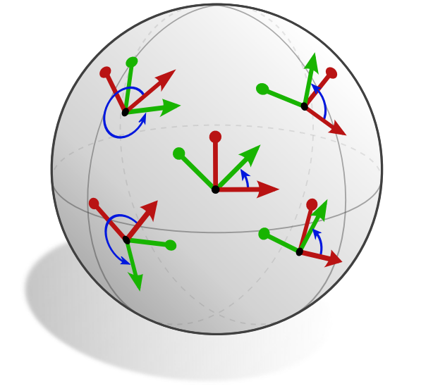
Main Idea: Global to Local
Invariance to Global Coordinate Transformation
Global Symmetry
Translation
Rotation
Invariance to Local Coordinate Transformation
Gauge Symmetry

Slide 6

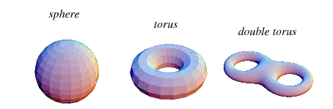
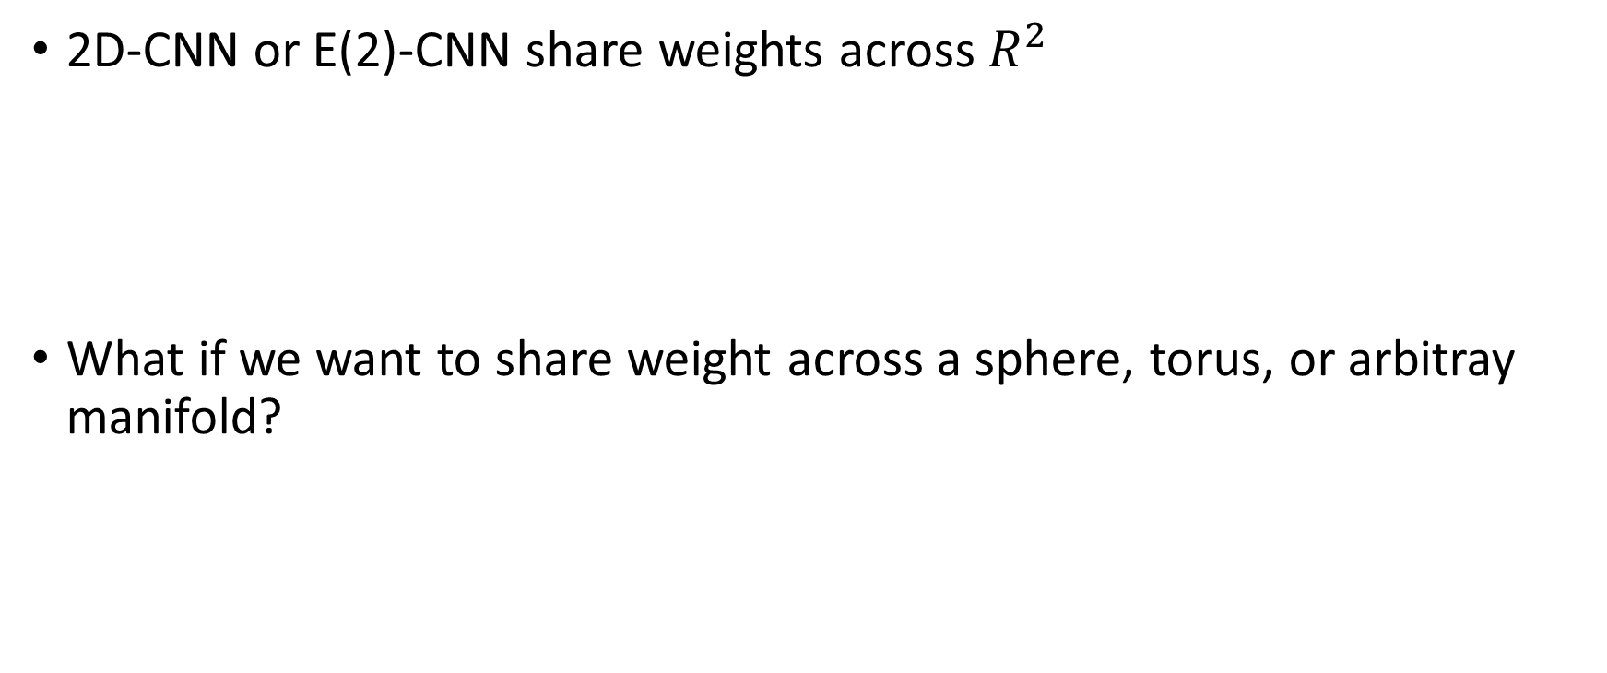
Weight-sharing on manifolds is hard
2D-CNN or E(2)-CNN share weights across $R^{2}$
What if we want to share weight across a sphere, torus, or arbitray manifold?
(same weights)
convolutional

Slide 7
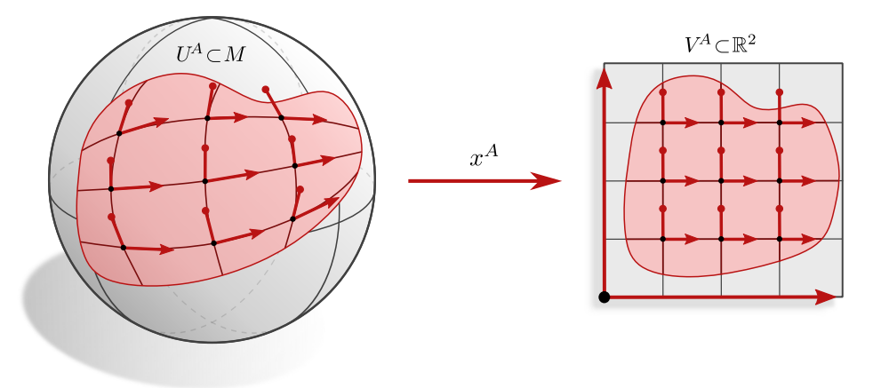
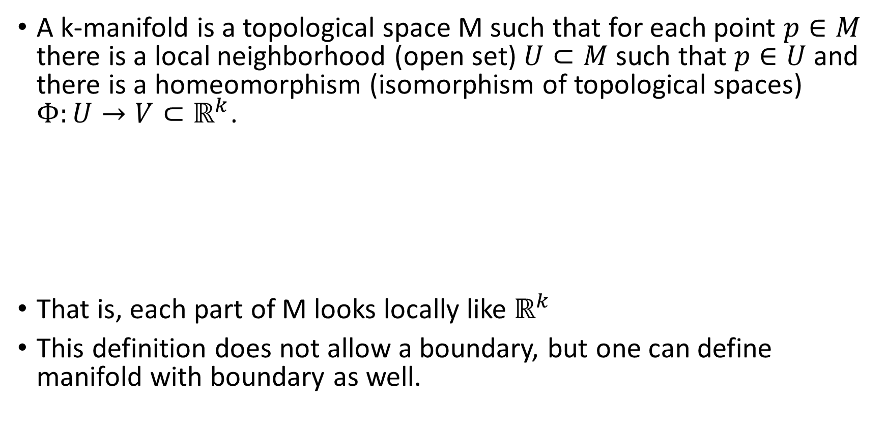
Manifolds
A k-manifold is a topological space M such that for each point $p∈M$ there is a local neighborhood (open set) $U⊂M$such that $p∈U$ and there is a homeomorphism (isomorphism of topological spaces) $Φ:U→V⊂ℝ^{k}$.
That is, each part of M looks locally like $ℝ^{k}$
This definition does not allow a boundary, but one can define manifold with boundary as well.

Slide 8
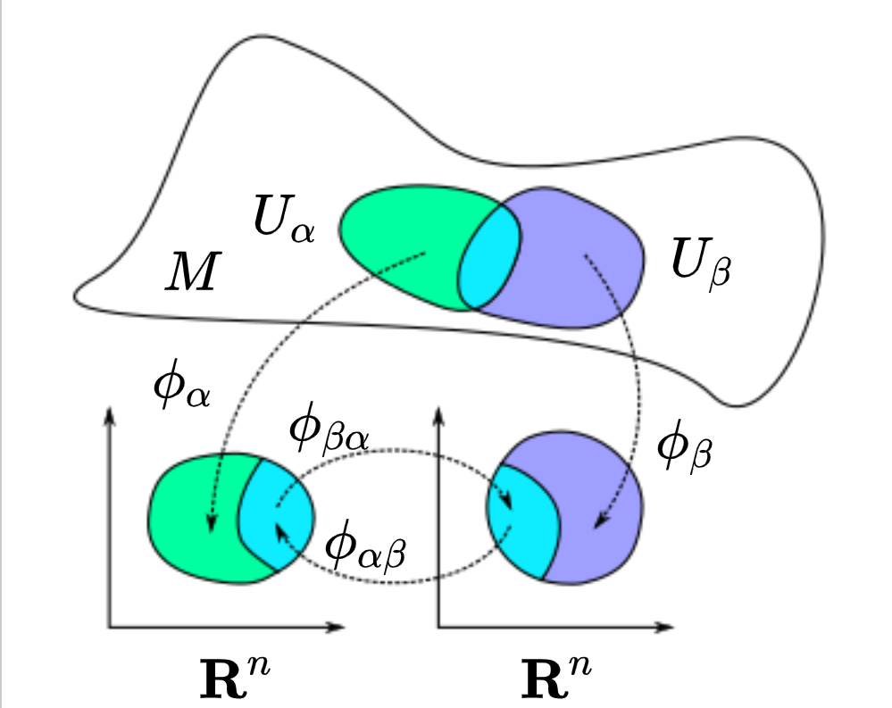
Differentiable Manifolds
The maps ${φ_{β}∘φ}_{α}^{−1}$are called transition maps. If these are infinitely differentiable (smooth) then the charts can be interpreted as diffeomorphisms and so we have a geometric structure on M and can differentiate functions $f:M→ℝ$

Slide 9
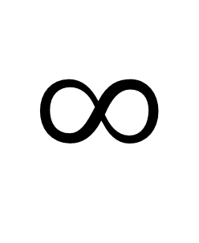
Examples
0
$$∞$$
1-Manifold
Not a 1-Manifold
1-Manifold with boundary

Slide 10
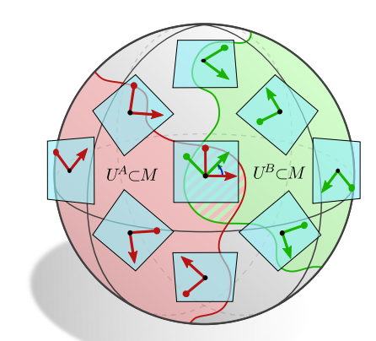
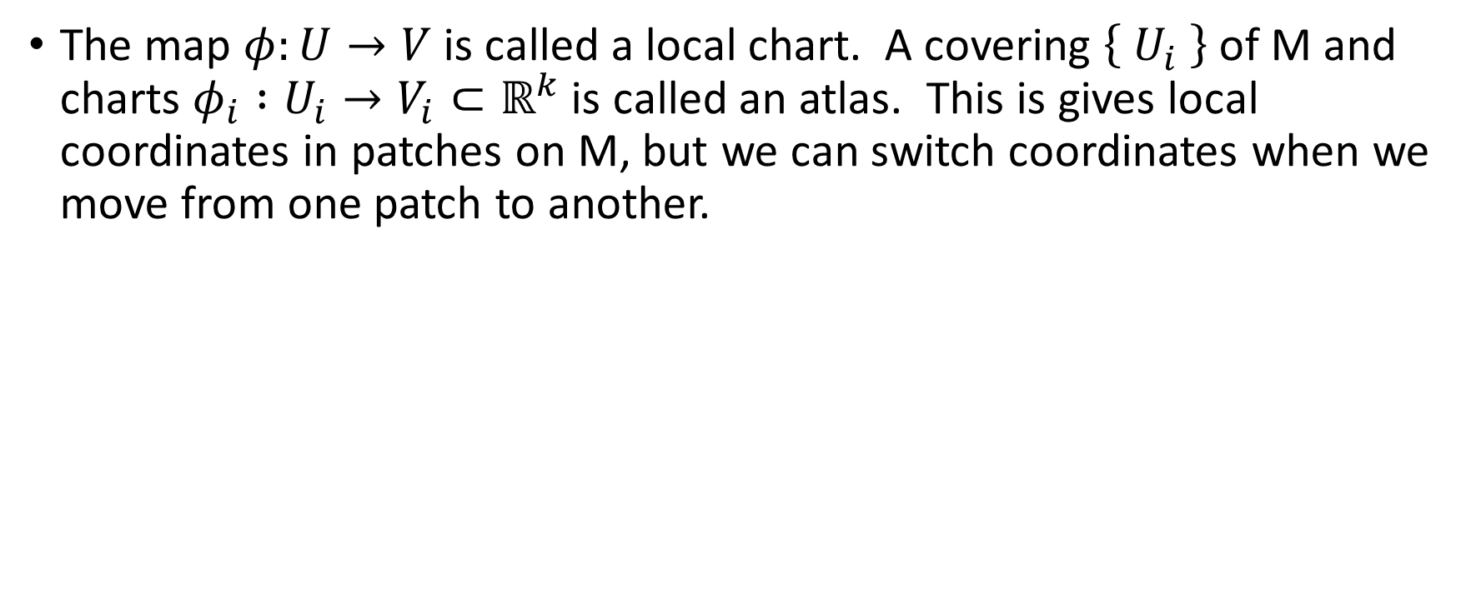
Atlases and Charts
The map $φ:U→V$is called a local chart. A covering $\left\{ U_{i} \right\}$ of M and charts $φ_{i} :U_{i}→V_{i}⊂ℝ^{k}$is called an atlas. This is gives local coordinates in patches on M, but we can switch coordinates when we move from one patch to another.

Slide 11
Coordinate Independence
Similar to other cases where we used equivariance in GDL where we wanted to remove dependence on arbitrary choices (coordinate frame, order).
Data over a manifold must be written with respect to some choice of local coordinates
The NN computation should be independent of that choice
One might hope it is possible to at least give a global reference frame to reduce the number of choices but this is often impossible too.

Slide 12
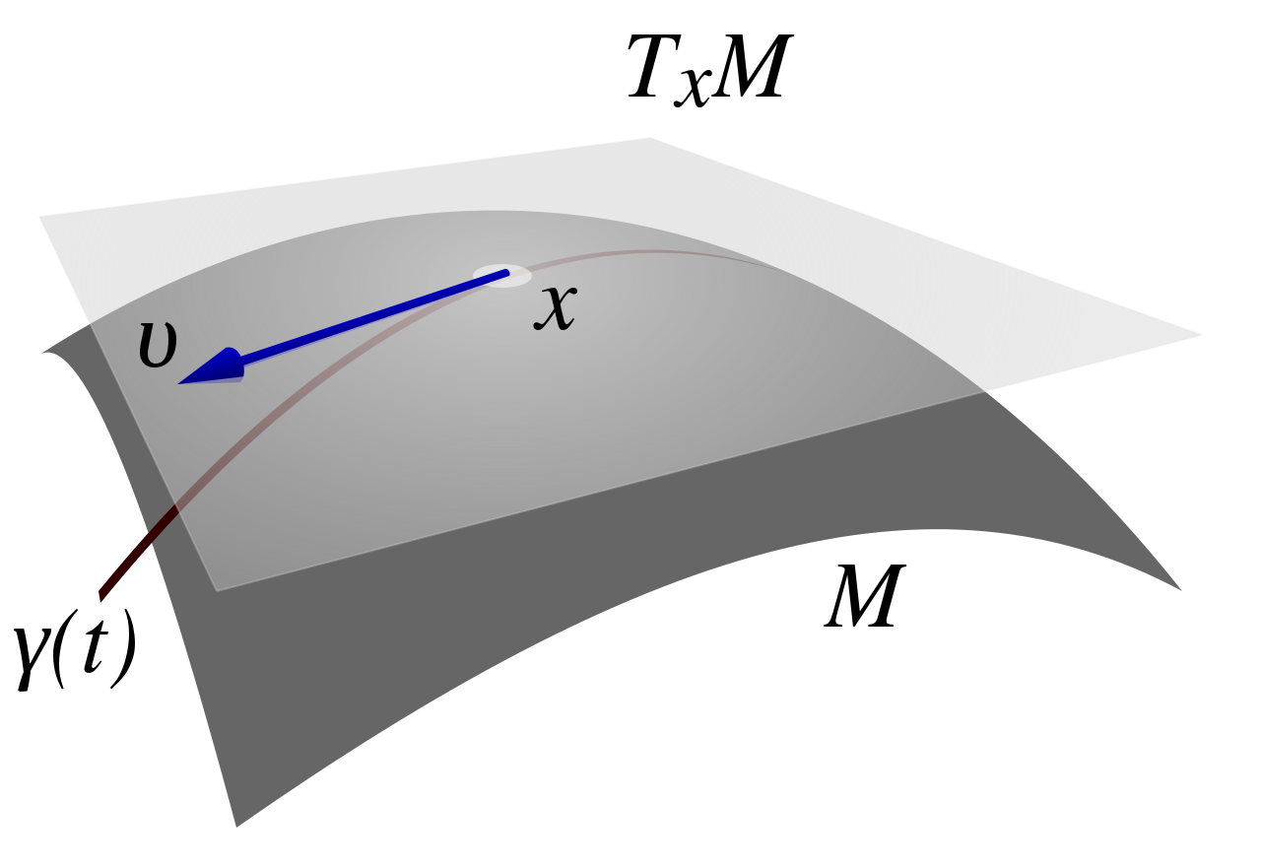
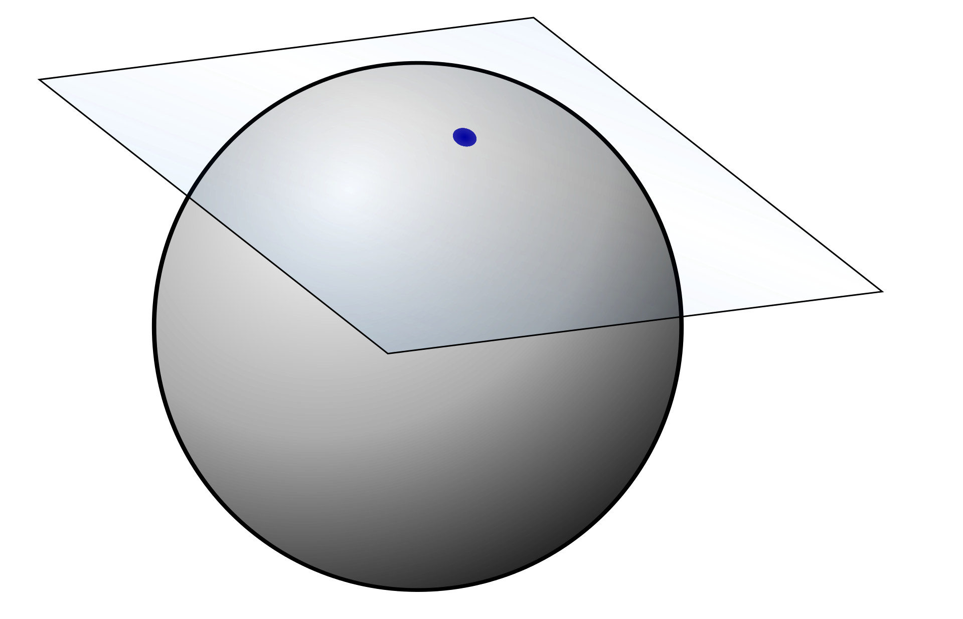
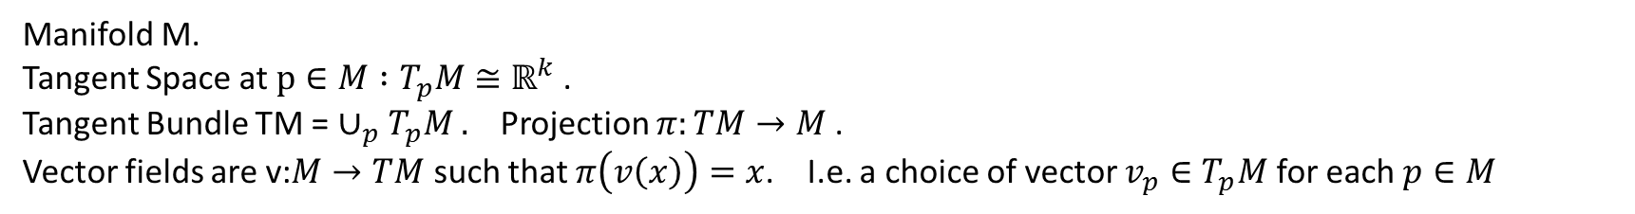
Tangent Bundle / Vector Bundle
Manifold M.
Tangent Space at $p∈M :T_{p}M$ $≅ℝ^{k}$ .
Tangent Bundle TM = $∪_{p}T_{p}M .$ Projection $π:TM→M$.
Vector fields are v:$M→TM$ such that $π\left(v\left(x\right)\right)=x$. I.e. a choice of vector $v_{p}∈T_{p}M$ for each $p∈M$

Slide 13
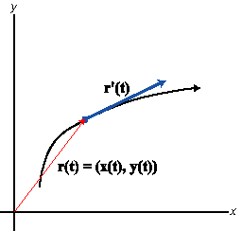
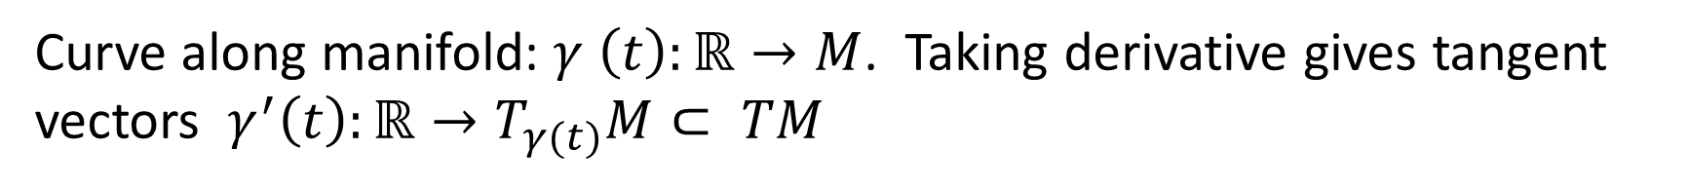
Tangent Vectors
Curve along manifold: $γ \left(t\right):ℝ→M$. Taking derivative gives tangent vectors $γ^{′}\left(t\right):ℝ→T_{γ(t)}M⊂ TM$

Slide 14
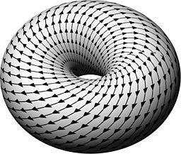
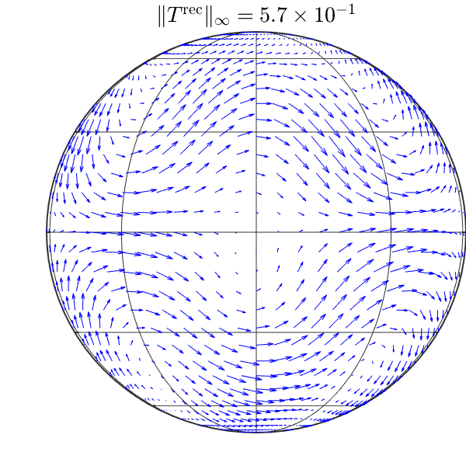
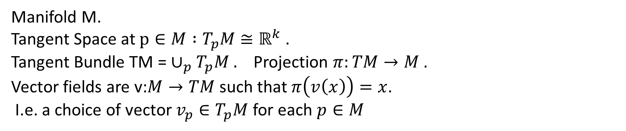
Vector Field on Manifold
Manifold M.
Tangent Space at $p∈M :T_{p}M$ $≅ℝ^{k}$ .
Tangent Bundle TM = $∪_{p}T_{p}M .$ Projection $π:TM→M$.
Vector fields are v:$M→TM$ such that $π\left(v\left(x\right)\right)=x$.
I.e. a choice of vector $v_{p}∈T_{p}M$ for each $p∈M$

Slide 15
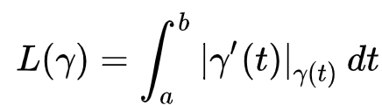
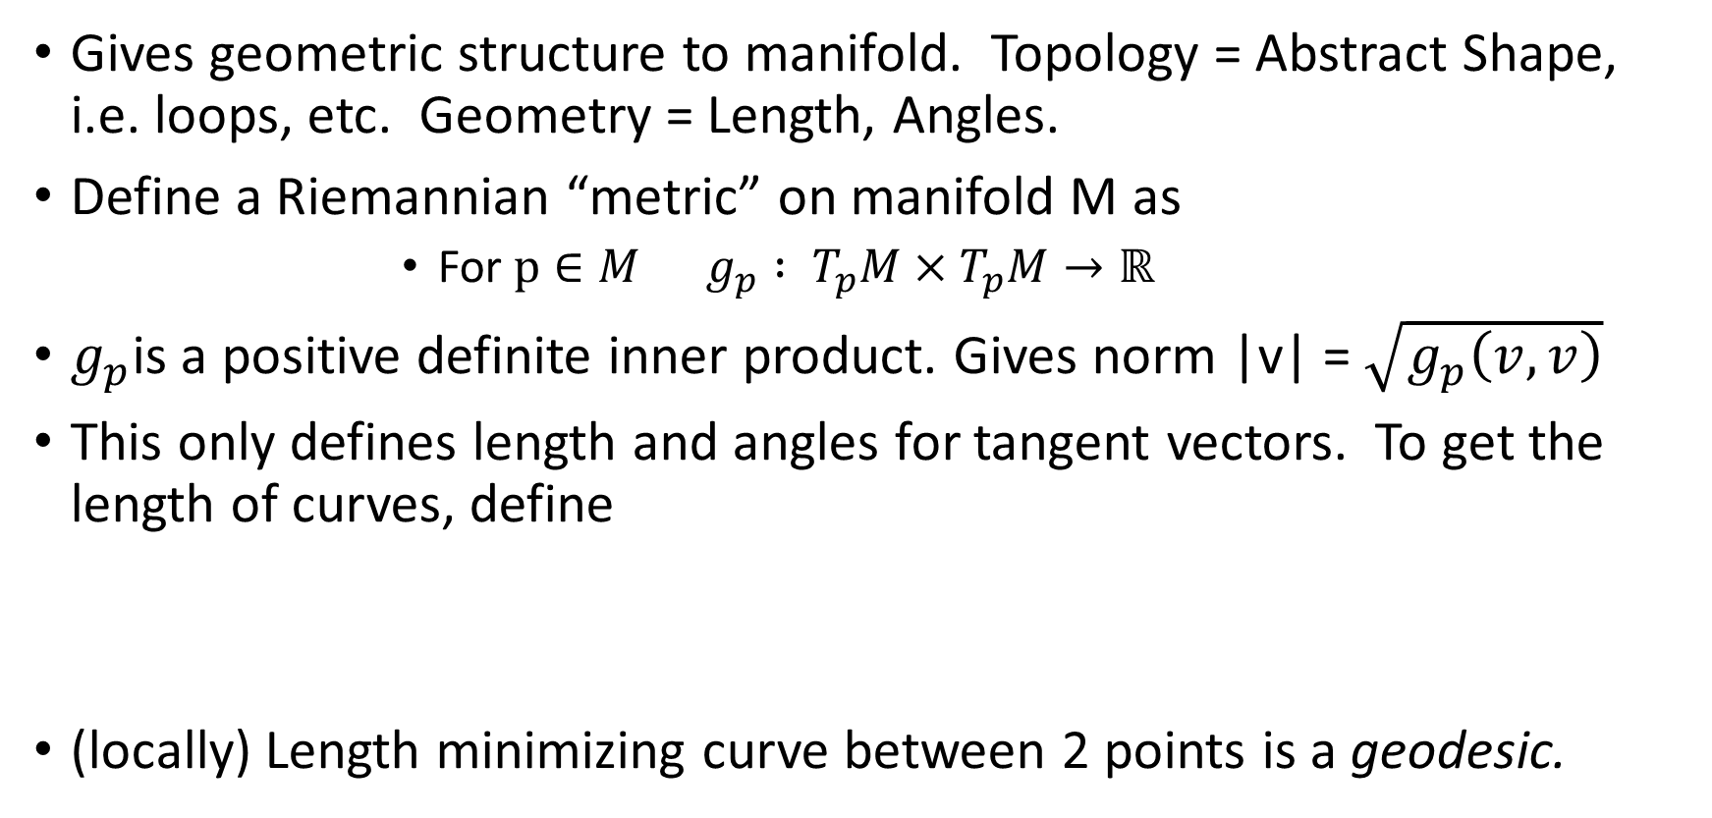
Riemannian Manifold
Gives geometric structure to manifold. Topology = Abstract Shape, i.e. loops, etc. Geometry = Length, Angles.
Define a Riemannian “metric” on manifold M as
For $p∈M g_{p} : T_{p}M×T_{p}M→ℝ$
$g_{p}$is a positive definite inner product. Gives norm |v| = $\sqrt{g_{p}\left(v,v\right)}$
This only defines length and angles for tangent vectors. To get the length of curves, define
(locally) Length minimizing curve between 2 points is a geodesic.

Slide 16
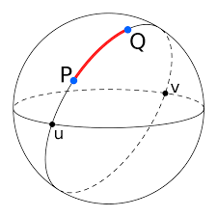
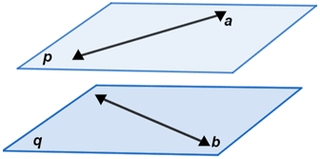
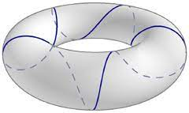
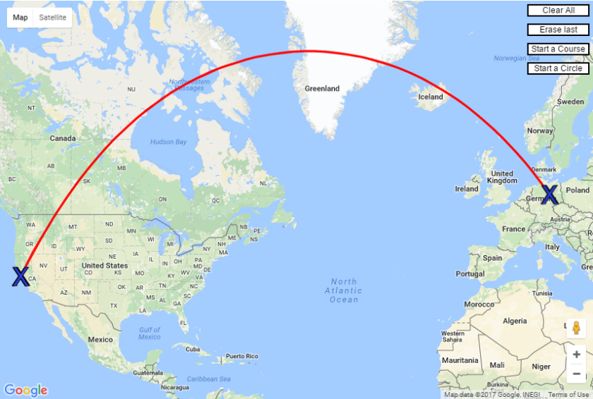
Geodesics

Slide 17
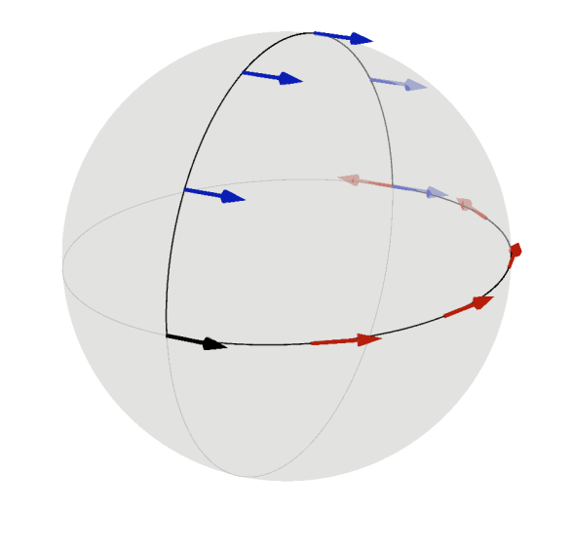
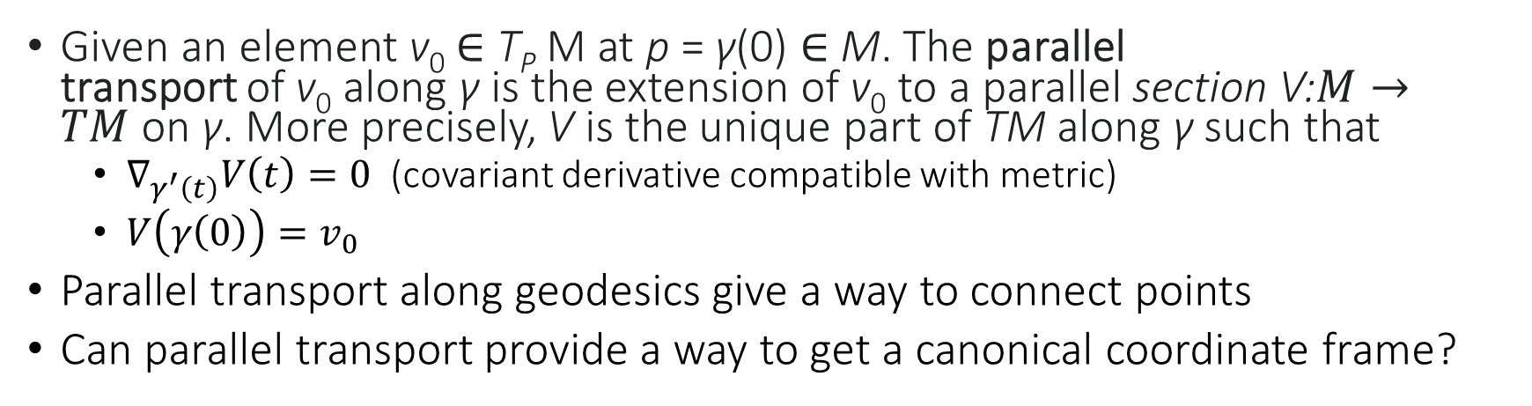
Parallel Transport
Given an element v₀ ∈ T_{P} M at p = γ(0) ∈ M. The parallel transport of v₀ along γ is the extension of v₀ to a parallel section V:$M→TM$ on γ. More precisely, V is the unique part of TM along γ such that
$∇_{γ^{′}\left(t\right)}V\left(t\right)=0$ (covariant derivative compatible with metric)
$V\left(γ\left(0\right)\right)=v_{0}$
Parallel transport along geodesics give a way to connect points
Can parallel transport provide a way to get a canonical coordinate frame?

Slide 18
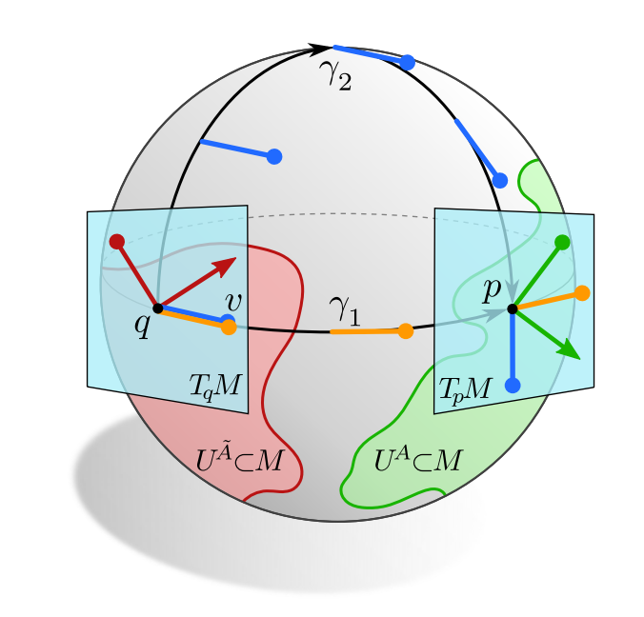
Cannot give consistent coordinates under parallel transport

Slide 19
How to attain Coordinate independence
Step 1: Understand transformations to local coordinate frames can result from parallel transport (gauge group)
Step 2: Build NN layers which are gauge group equivariant. They are then independent of choice of local coordinates.
Step 3: Gauge equivariant NNs

Slide 20
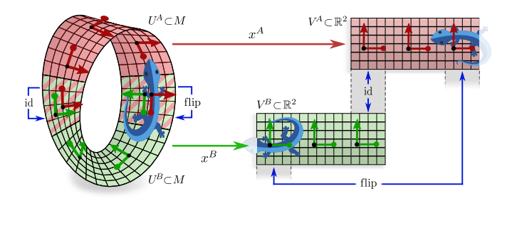
Gauge Transform

Slide 21
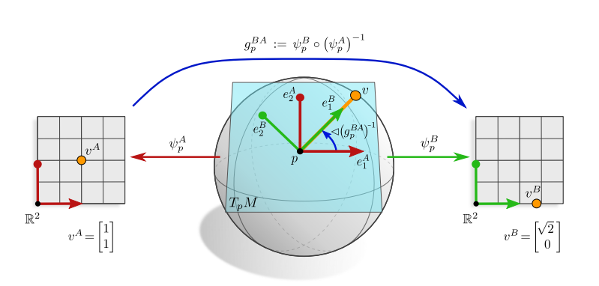
Gauge Transform between choices of local frames

Slide 22
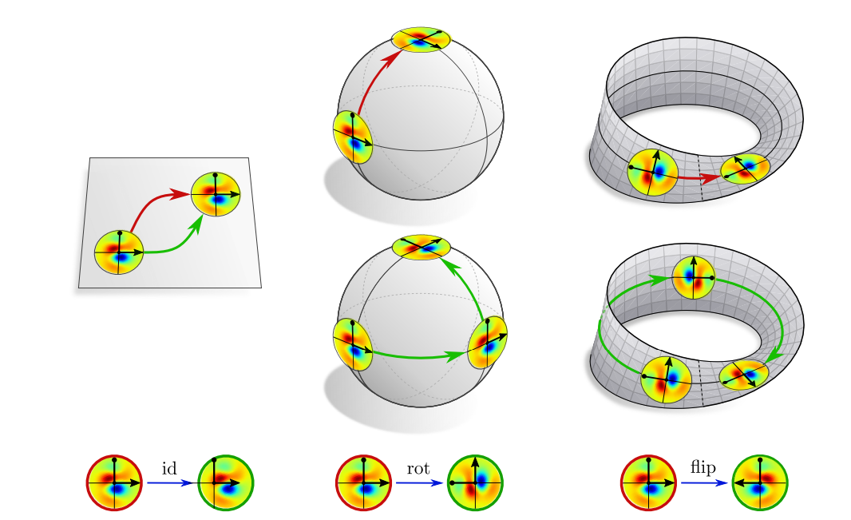
Topology, Orientability, and Orthogonality Influence the Gauge Group

Slide 23
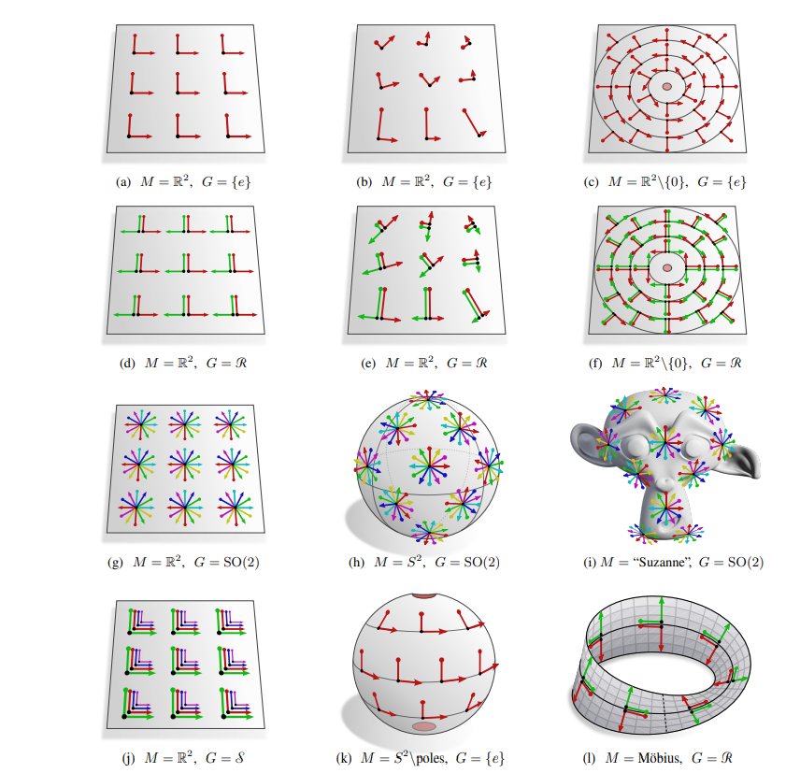
Gauge Groups

Slide 24
How to be gauge equivariant?

Slide 25
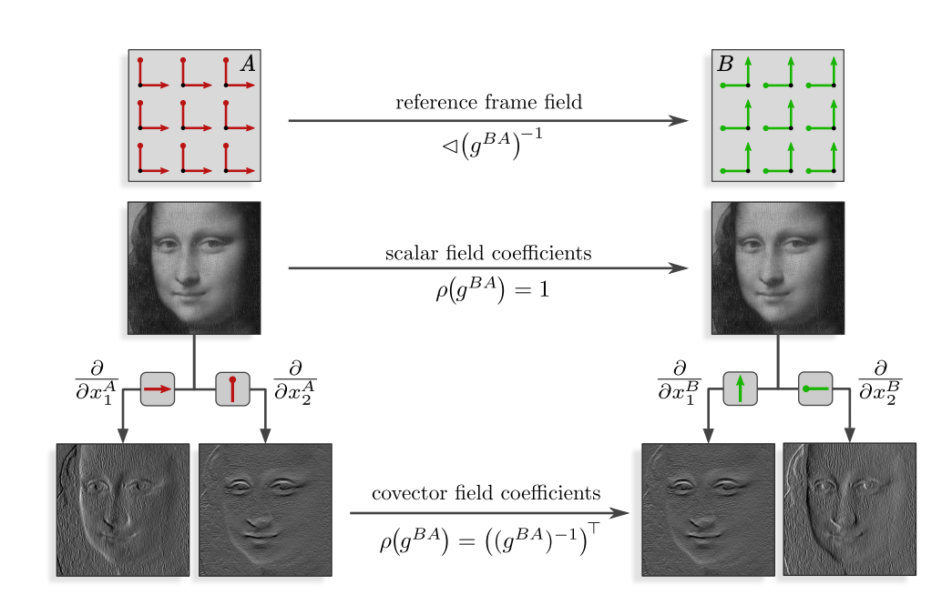
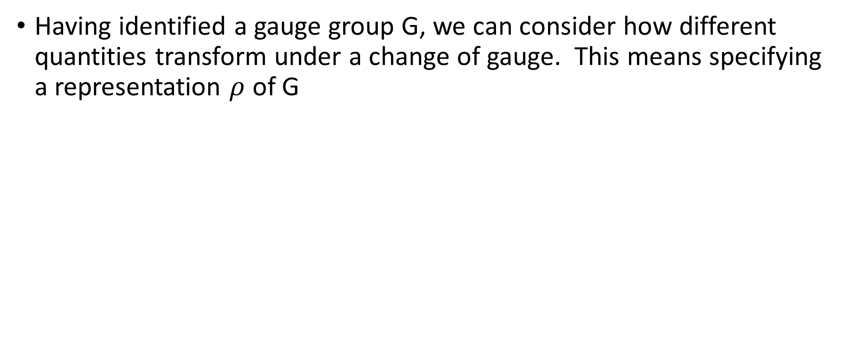
Different types of fields
Having identified a gauge group G, we can consider how different quantities transform under a change of gauge. This means specifying a representation $ρ$ of G

Slide 26
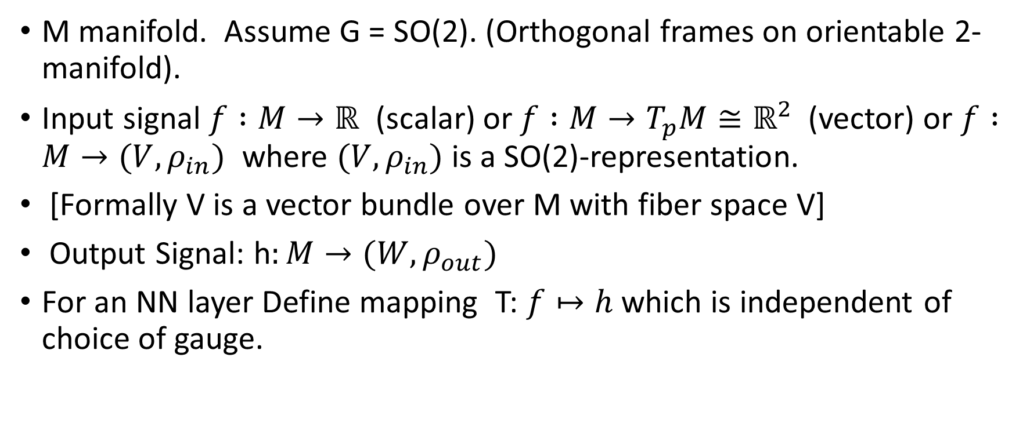
Abstract Version of Gauge Equivariant Operation
M manifold. Assume G = SO(2). (Orthogonal frames on orientable 2-manifold).
Input signal $f :M→ℝ$ (scalar) or $f :M→T_{p}M≅ℝ^{2}$ (vector) or $f :M→(V,ρ_{in})$ where $(V,ρ_{in})$ is a SO(2)-representation.
[Formally V is a vector bundle over M with fiber space V]
Output Signal: h$:M→(W,ρ_{out})$
For an NN layer Define mapping T: $f↦h$ which is independent of choice of gauge.

Slide 27
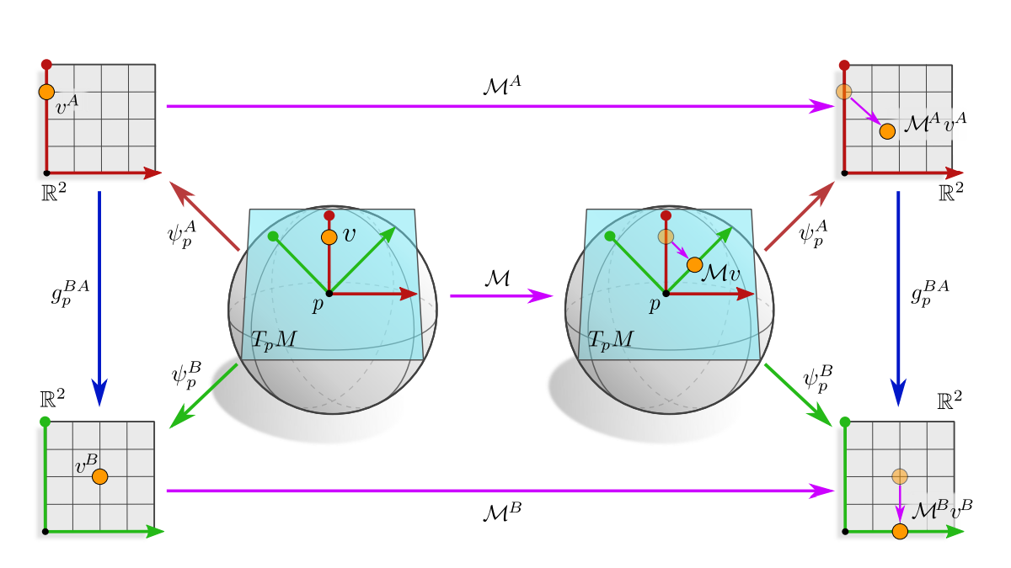
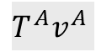

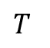
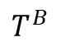
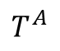
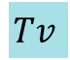
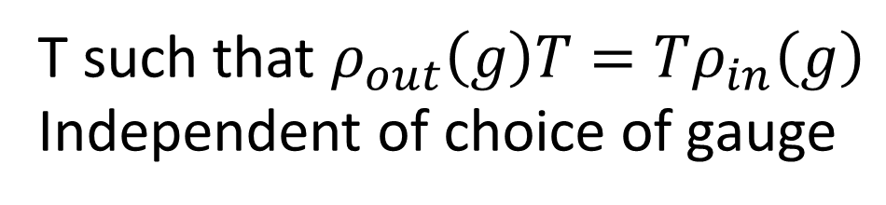
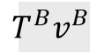
Gauge Equivariance Commutative Diagram
$$T^{A}$$
$$T^{A}v^{A}$$
$$T$$
$$Tv$$
$$T^{B}$$
$$T^{B}v^{B}$$
$${ρ_{out}\left(g\right) T}^{A}=T^{B}ρ_{in}\left(g\right)$$
T such that $ρ_{out}\left(g\right)T=Tρ_{in}\left(g\right)$ Independent of choice of gauge

Slide 28
Gauge Equivariant Mesh CNNs

Slide 29
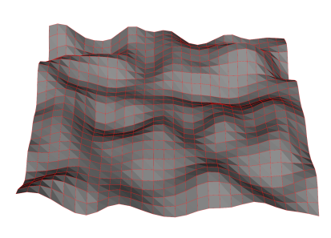
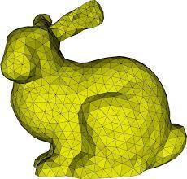
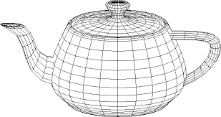
2-Manifolds as Meshes

Slide 30


Simplify Choice of Local Frame
Gauge Group: SO(2).
Simplify choice of local frame in terms of reference neighbor. A single neighbor defines a unit vector in the tangent plane. $\frac{ π}{2}$ rotated version (in positive orientation w.r.t normal) gives basis of tangent space.
A graph convolution would have the same weights for each neighbor
A continuous convolution on the tangent planes would depend on choice of $θ=0$
Gauge-equivariant mesh CNN is local coordinate independent and anisotropic (orientation dependent)

Slide 31

Parallel Transport on a Mesh
Parallel transport is a rotation with respect to normals.
Also need to compute transition between different gauges.

Slide 32



Graph Conv to Gauge-Equivariant Conv
GNN
Add orientation dependence and parallel transport
Need to fix: $θ_{pq}$depends on gauge

Slide 33



We already know how to make convolutions SO(2)-equivariant!
The kernel K gives an SO(2) - equivariant convolution if
$$K\left(gx\right)=ρ_{out}\left(g\right)K\left(x\right)ρ_{in}{\left(g\right)}^{−1}$$
In this case we don’t care about radius, only angle, so we parameterize $K(θ)$ giving

Slide 34

Gauge Equivariance

